Slide 1
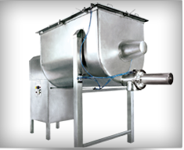
RIBBON BLENDER
Mfg.& Exp. Of Plants & Machineries for Pharmaceuticals,
Cosmetics, Chemicals food & Beverage Industries
Plot No. 1601/1,3rd Phase G.I.D.C., Vapi-396195. (Gujarat)
Email:sales@sidhipharmaequiment.com:sidhipharmaequipments@gmail.com:
Contact Person : Mr. Pravin Panchal (9924893790) Mr. Kiran Gophane (9545868896)
Website: www.sidhipharmaequipment.com

Slide 2
Ribbon Blender:
Ribbon Blender (also named ribbon mixer) is a basic industrial mixing machine. They consist, basically, of a trough-shaped shell (usually 2 to 3 times longer than it is wide) with a semicircular bottom, fitted with a horizontal longitudinal shaft on which are mounted arms supporting a combination of ribbon blades, paddles or helical screws set at a fairly close clearance to the semicircular mixer body so that no layer of material remains on the bottom of the ribbon mixer. The most effective design of ribbon layout is the double spiral in which the outer ribbon moves the product in one direction and the inner ribbon moves it in the opposite direction.
The ribbons rotate and move materials both radically and laterally to insure thorough blends in short cycle times. Ribbon agitators are used for blends that will be between 40 and 70% of the rated capacity of ribbon blend.

Slide 3
Silent Features :
Air purge on the side entry seals for better cross contamination control.
Continuous Ribbon design for complete discharge of the finished product.
Belt driven power transmission for Quieter environment and less maintenance.
Paddle style agitator instead of Ribbon for Blending fragile materials.
Bearing mounted on lanterns out of mixing zone to avoid Cross contamination.
Reduced Material handling due to side discharge facility of processed materials.
Advantageous\ Benefits :
Mild mixing which will not break the physical size of material
More loading factor:
Easy Cleaning: usually, the opening at ribbon blender’s top cover is very large to touch into the inner surface for cleaning purpose.
Easy Maintenance: the structure of ribbon blender is very simple, easy to dismantle and maintenance
Low Power Energy

Slide 4
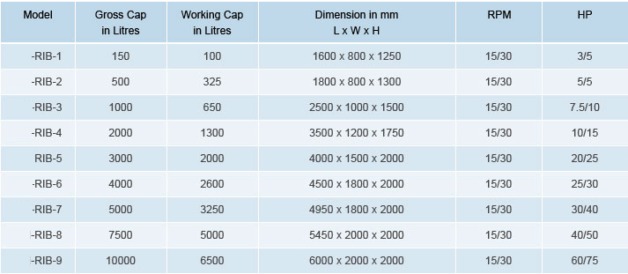
Technical Specification :
Single Source Provider for all your technical requirements.
One of the most important “Siddhi Pharma Equipment” guideline is to be closest to our Customers. We strive to create end-to-end solutions that meet our clients needs and their expectation.
Application :
Pharmaceutical
Food
Chemical
Cosmetics
Allied Industry

